Slide 1

IT 353 Web Development Technologies
Jianwei Lai
jlai12@ilstu.edu

Slide 2
Content for today
Introduction to web applications
html basics

Slide 3
What is a Web application?
A web application is an application that is accessed by users using a web browser, e.g., Google Docs
desktop vs web applications
Google Docs vs Microsoft word
Web application vs website
Notes:
https://www.visionmobile.com/blog/2013/07/web-sites-vs-web-apps-what-the-experts-think

Slide 4
Why we need Web applications?
Installed only on the web server
Accessible anywhere
Easy maintenance, support and patches
Accessible for a range of devices, cross platform
Security
Flexible core technologies
Notes:
http://www.magicwebsolutions.co.uk/blog/the-benefits-of-web-based-applications.htm

Slide 5
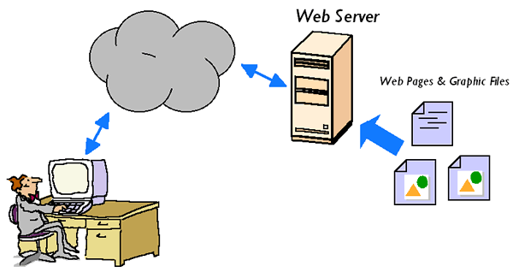
How a Web server works?
http://www.resultantsys.com/index.php/general/what-is-a-web-application-server/
Notes:
http://www.resultantsys.com/index.php/general/what-is-a-web-application-server/
The user requests a web page. The Web Server finds the web page file in a local directory and sends it back out to the user. When graphic files are requested, the same thing happens. The Web Server finds the requested graphic files and sends them back to the user. The Web Server standards were originally designed to publish static documents on the Internet. There was a limited capability for accessing dynamic content, but this was never intended to support high volume, highly interactive Web applications.

Slide 6
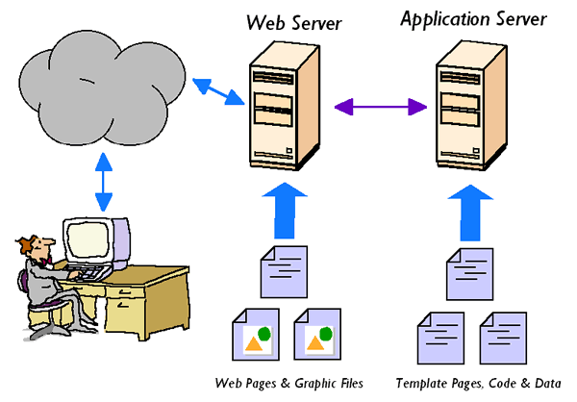
How a Web application server works?
Notes:
Web application servers are designed specifically to extend web servers to support dynamic content. The application server software “hooks in” to the web server software and automatically intercepts any user requests for dynamic content. The web server still sends out static web pages and graphic files–Just like before. But now, the application server can create dynamic content by mixing data with templates, running programs, or by accessing databases.

Slide 7
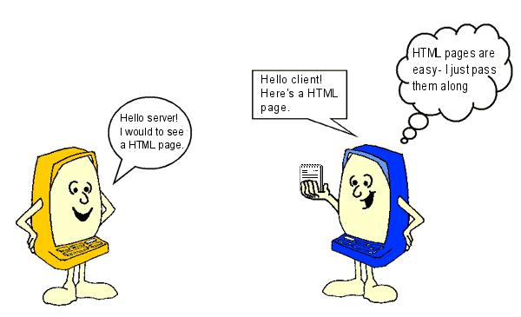
What is HTML?
HTML stands for Hyper Text Markup Language
A markup language is a set of markup tags
HTML documents are described by HTML tags
Each HTML tag describes different document content
Versions
HTML, HTML 2.0, HTML 3.0, HTML 3.2, HTML 4.0. HTML 4.01, XHTML, HTML 5
Notes:
Book: Head first HTML and CSS page 2
W3schools.com
http://www.w3schools.com/html/html_intro.asp

Slide 8

What is HTML?
<!DOCTYPE html> <html>
<head> <title>Page Title</title> </head>
<body> <h1>My First Heading</h1> <p>My first paragraph.</p> </body>
</html>
Head
Body

Slide 9
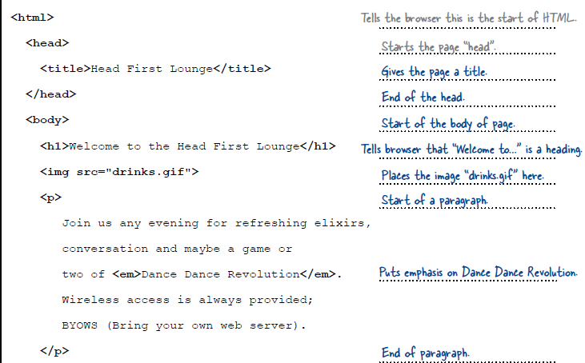
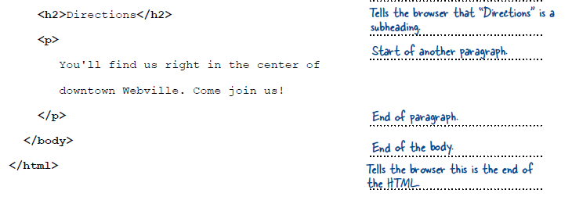

Slide 10
Try it out!
https://www.w3schools.com/html/tryit.asp?filename=tryhtml_default

Slide 11
History of HTML
1991
HTML first published
1995
HTML 2.0
After HTML 4.01 was released, focus shifted to XHTML and its stricter standards.
1997
HTML 3.2
1999
HTML 4.01
XHTML 2.0 had even stricter standards than 1.0, rejecting web pages that did not comply. It fell out of favor gradually and was abandoned completely in 2009.
2000
XHTML 1.0
2002 -2009
HTML5 is much more tolerant and can handle markup from all the prior versions.
XHTML 2.0
HTML5
Though HTML5 was published officially in 2012, it has been in development since 2004.
2012

Slide 12
What is HTML5?
HTML5 is the new version of HTML
It incorporates all features from earlier versions of HTML, including the stricter XHTML.
It adds a diverse set of new tools for the web developer to use.
https://html5test.com/results/desktop.html

Slide 13
New Elements in HTML5
<aside>
<article>
<audio>
<canvas>
<datalist>
<figure>
<figcaption>
<footer>
<header>
<hgroup>
<mark>
<nav>
<progress>
<section>
<source>
<svg>
<time>
<video>

Slide 14
Why Semantic HTML5 Elements?
With HTML4, developers used their own favorite attribute names to style page elements.
This made it impossible for search engines to identify the correct web page content.
With HTML5 elements like: <header> <footer> <nav> <section> <article>, this will become easier.
http://www.w3schools.com/html/html5_semantic_elements.asp

Slide 15
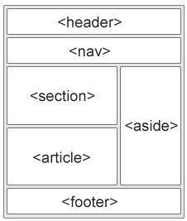
New Semantic Elements
https://www.w3schools.com/html/tryit.asp?filename=tryhtml5_section

Slide 16
Try it out
https://www.w3schools.com/tags/tag_div.ASP

Slide 17
Other New Features in HTML5
The Canvas (a way to draw directly on a web page)
Built-in audio and video support (without plugins)
Drag and Drop functionality
Support for CSS3 (the newer and more powerful version of CSS)
More advanced features for web developers, such as data storage and offline applications.

Slide 18
First Look at HTML5
Remember the DOCTYPE declaration from XHTML?
<!DOCTYPE html PUBLIC "-//W3C//DTD XHTML 1.0 Transitional//EN"
"http://www.w3.org/TR/xhtml1/DTD/xhtml1-transitional.dtd">
In HTML5, there is just one possible DOCTYPE declaration and it is simpler:
<!DOCTYPE html>
Just 15 characters!
The DOCTYPE tells the browser which type and version of document to expect. This should be the last time the DOCTYPE is ever changed. From now on, all future versions of HTML will use this same simplified declaration.

Slide 19
The <html> Element
This is what the <html> element looked like in XHTML:
<html xmlns="http://www.w3.org/1999/xhtml" xml:lang="en" lang="en">
Again, HTML5 simplifies this line:
<html lang="en">
The lang attribute in the <html> element declares which language the page content is in. Though not strictly required, it should always be specified, as it can assist search engines and screen readers.
Each of the world’s major languages has a two-character code, e.g. Spanish = "es", French = "fr", German = "de", Chinese = "zh", Arabic = "ar".

Slide 20
The <head> Section
Here is a typical XHTML <head> section:
<head>
<meta http-equiv="Content-type" content="text/html; charset=UTF-8" />
<title>My First XHTML Page</title>
<link rel="stylesheet" type="text/css" href="style.css" />
</head>
And the HTML5 version:
<head>
<meta charset="utf-8">
<title>My First HTML5 Page</title>
<link rel="stylesheet" href="style.css">
</head>
Notice the simplified character set declaration, the shorter CSS stylesheet link text, and the removal of the trailing slashes for these two lines.

Slide 21
Basic HTML5 Web Page
Putting the prior sections together, and now adding the <body> section and closing tags, we have our first complete web page in HTML5:
UTF-8 (Unicode) covers almost all of the characters and symbols in the world.
<!DOCTYPE html>
<html lang="en">
<head>
<meta charset="utf-8">
<title>My First HTML5 Page</title>
<link rel="stylesheet" href="style.css">
</head>
<body>
<p>HTML5 is fun!</p>
</body>
</html>
Let's open this page in a web browser to see how it looks…

Slide 22
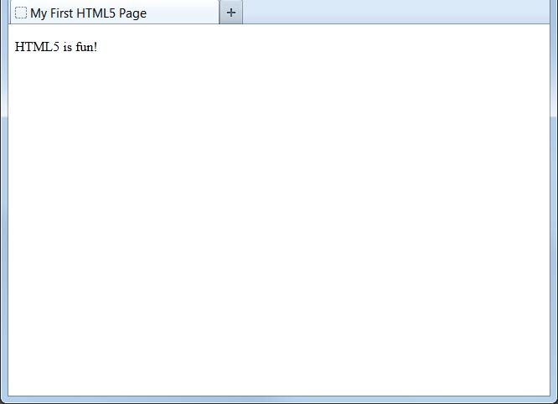
Viewing the HTML5 Web Page
Even though we used HTML5, the page looks exactly the same in a web browser as it would in XHTML. Without looking at the source code, web visitors will not know which version of HTML the page was created with.

Slide 23
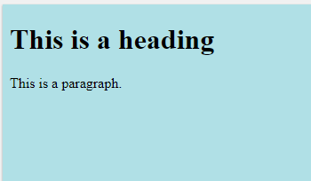
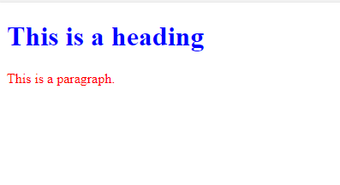
Style
<!DOCTYPE html>
<html>
<body style="background-color:powderblue;">
<h1>This is a heading</h1>
<p>This is a paragraph.</p>
</body>
</html>
<!DOCTYPE html>
<html>
<body>
<h1 style="color:blue;">This is a heading</h1>
<p style="color:red;">This is a paragraph.</p>
</body>
</html>

Slide 24
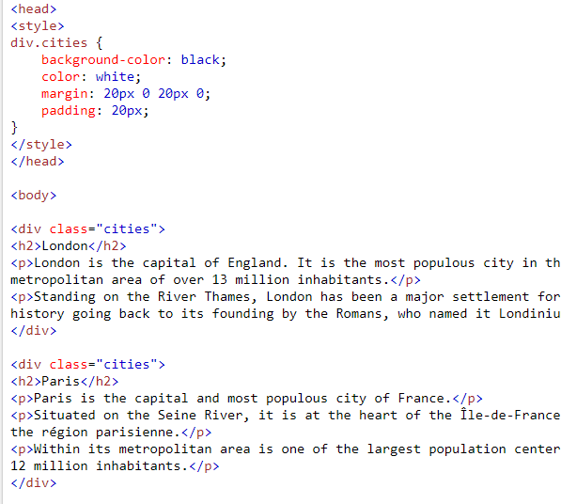
The class Attribute
The HTML class attribute makes it possible to define equal styles for elements with the same class name.
https://www.w3schools.com/html/tryit.asp?filename=tryhtml_classes_capitals
Notes:
<!DOCTYPE html>
<html>
<head>
<style>
div.city {
background-color: tomato;
color: white;
border: 2px solid black;
margin: 20px;
padding: 20px;
}
</style>
</head>
<body>
<div class="city">
<h2>London</h2>
<p>London is the capital of England.</p>
</div>
<div class="city">
<h2>Paris</h2>
<p>Paris is the capital of France.</p>
</div>
<div class="city">
<h2>Tokyo</h2>
<p>Tokyo is the capital of Japan.</p>
</div>
</body>
</html>

Slide 25
Before next class
Read HTML tutorial on W3Schools
https://www.w3schools.com/html/html_styles.asp

Slide 26
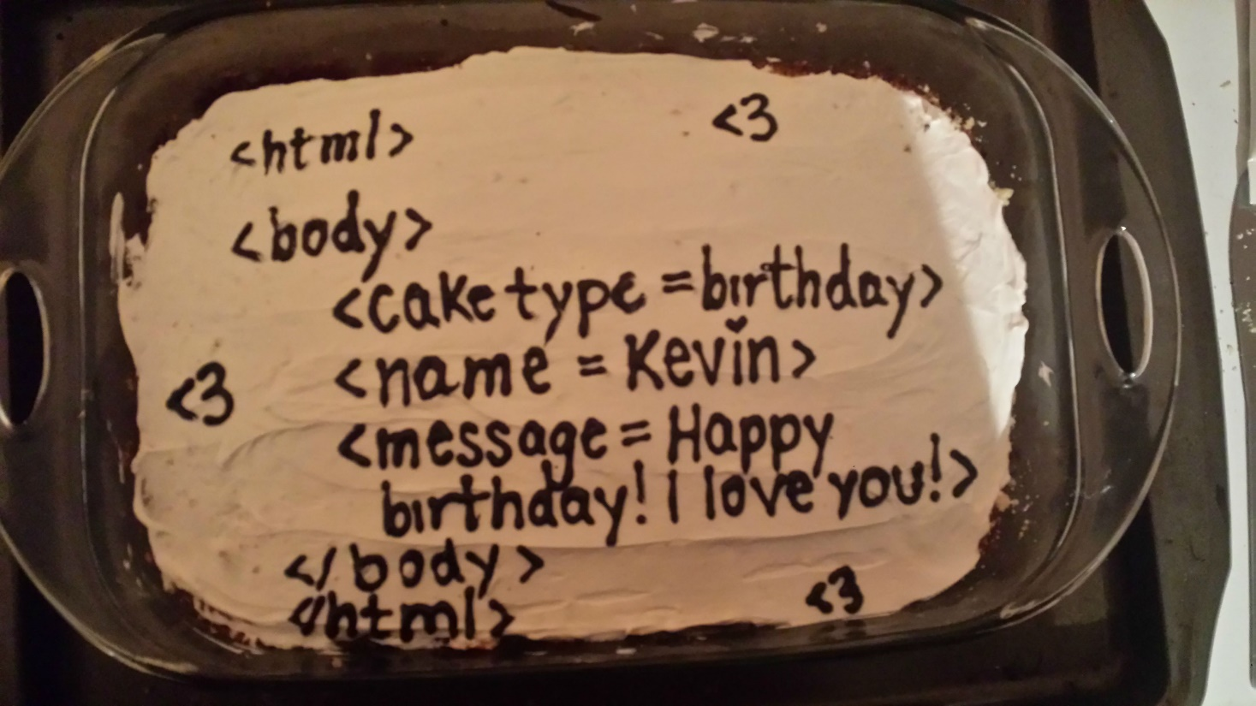
Summary
Introduction to Web application
Basics of HTML
New elements of HTML5
Style
Class

